Slide 1
Girl Scout Cookies Classifier
Austin Bennett
324855

Slide 2

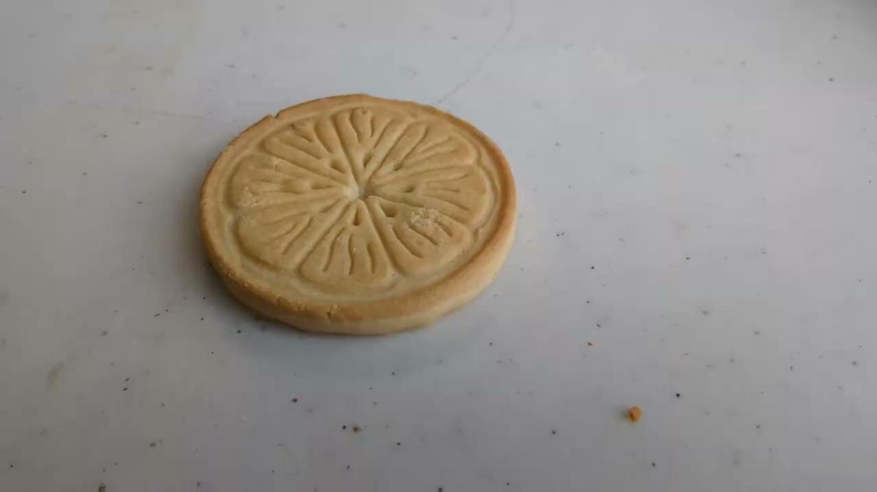
Cookies

Slide 3
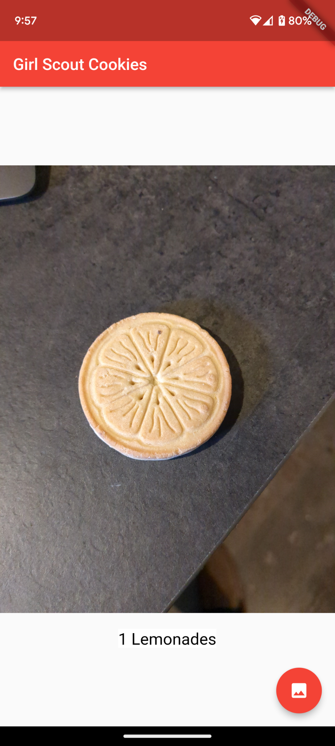
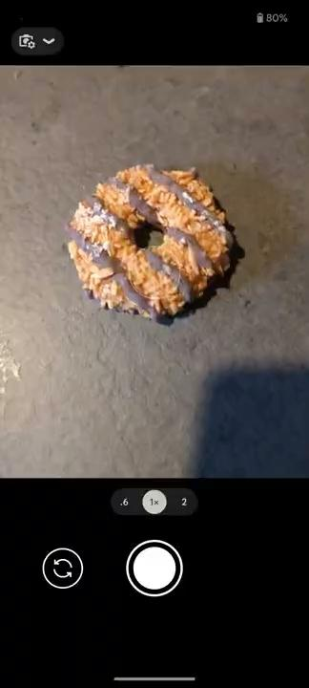
App
Built using Flutter and Tensorflow Lite
Will read a girl scout cookie and return the result.

Slide 4
Conclusion
I learned that it was really easy to make an app that can recognize objects.
The hardest part was getting the camera access with Flutter.

